Slide 1
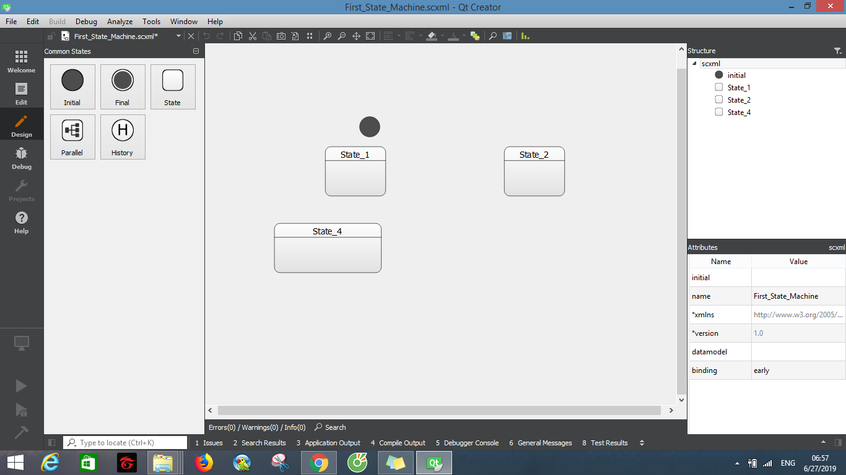
QT CREATOR

Slide 2
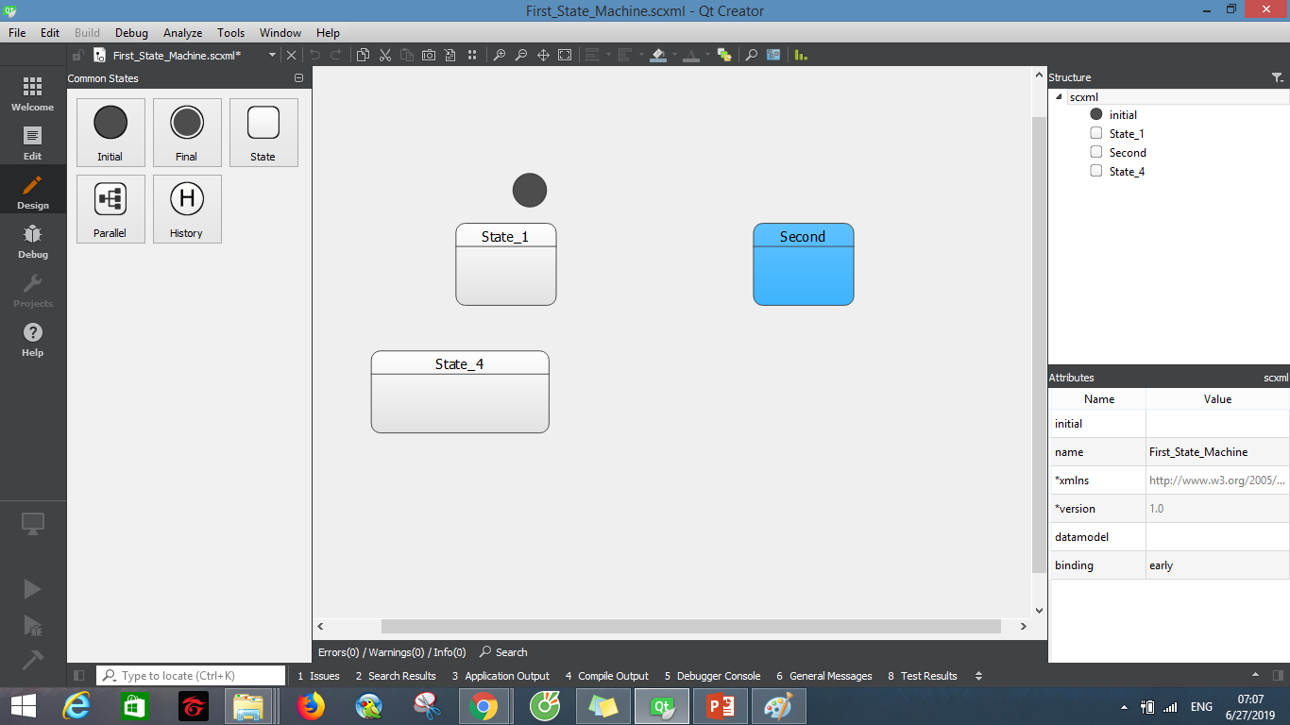
QT CREATOR

Slide 3
QT CREATOR
State
Transition
Events
Data model
Can change color of each state.
Editor SCXML available from QtCreator 4.2

Slide 4
QT CREATOR
Theme is easily to use.
Can view statisc of structure (how many state, how many scxml file will be created, max level of structure).
Can change color of each state.
Can export to image
Snapshot picture
Change size of state
Have symbol for state start and final
Support diff to view difference between modified file and last saved file

Slide 5
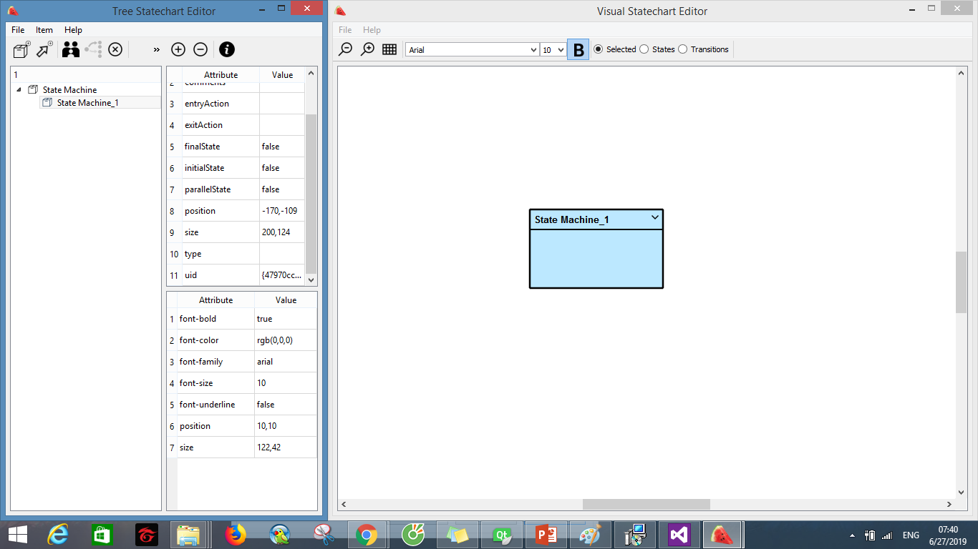

Slide 6
Visual statechart
Just edit directly on graphic, can’t edit use nagivator tool on the left like Qt Creator
Not consistency in between two windows
Can change size but have used text, not change on graphic
Small size
Not support to view scxml directly, first we have to save the chart then we can view it
It take much %CPU. Around 30% so although it has small size but take much CPU

Slide 7
Yakindu state chart tool
Support many operating system (Linux, Windows, MACOSX)
Two kind of version free and commercial

